Slide 1


Business Idea : Seasonal Farming
Presented to:
Pijush Kumar Sarkar
Lecturer
Department of Computer Science & Engineering
Uttara University

Slide 2
Meet our Team Members:
 | Md. Kowser Mahmod (2233081 349)
 | Md. Mahmudul Hassan (2233081 348)
 | Md. Riad Hasan (2233081 332)
 | Niloy Hasan Nahid (2233081 350)
 | Lutfun Nahar Barsha (2233081 334)
 | Nishat Tamanna (2233081 050)
Course Code : GED0413201
Course Name : ENTREPRENEURSHIP: Innovation and Commercialization

Slide 3
Table of Contents
01
02
03
05
06
04
Introduction of the Business Idea
Problems & Solution
Market Policy & Revenue Model
Market and Consumer Targeting
Future Prospects & Impacts
Organizational Chart

Slide 4
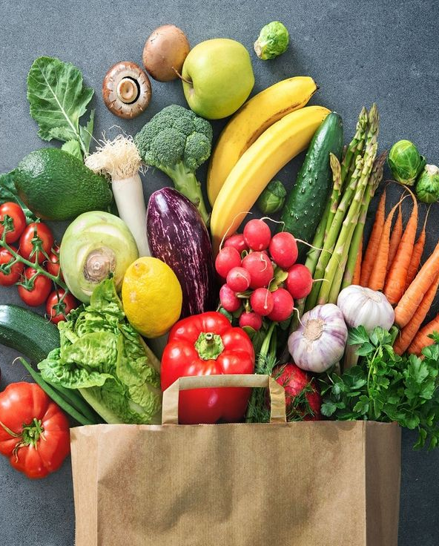
Business Idea and Objectives
We will hire farmers with their lands for farming seasonal vegetables and fruits. We’ll go for fruits in Summer and Vegetables in Winter.
Objectives : To provide pesticide-free mangoes and vegetables, leveraging local lands and experienced farmers in targeted regions.
Regions :
Mangoes – Rajshahi, Naogaon, Chapainawabganj;
Vegetables – Joypurhat, Bogura, Naogaon, Pabna.

Slide 5
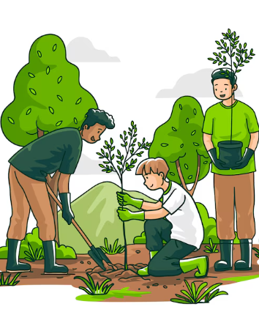
Green for Lives

Slide 6
Introduction
Our company :
Nature’s Basket
Our idea :
Cultivating Healthy pesticides free Foods

Slide 7
Problem Statements
Problems
Solution Overview
High demand for fresh, medicine-free foods; many farmers lack resources for profitable crop production.
Partnering with local farmers for land usage to produce seasonal crops, ensuring natural cultivation methods.

Slide 8
Operation Model
Phase 1 :
Partnership with Farmers
Phase 2:
Revenue Growth and Land Acquisition
Farmers retain land ownership. We provide necessary resources and share profits.
Cost Support : Provide fertilizers, seeds, and initial training.
Use revenue to acquire lands and establish company-owned farms.
Hire and train farmers under company standards for medicine-free farming.

Slide 9
Market Policy and Revenue Model
Market Policy:
Revenue Streams:
Focus on organic, medicine-free branding to attract health-conscious consumers.
Build a regional network in targeted districts to streamline supply chain logistics.
Direct sales to organic stores, local markets, and online fresh food platforms.
Collaborations with retailers focusing on organic produce.

Slide 10
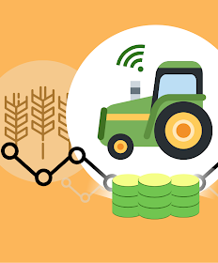
Target Market and Consumer Profile
Target Market: Health-conscious individuals, urban households, organic stores.
Consumer Profile: Middle to high-income groups who prioritize quality over cost

Slide 11
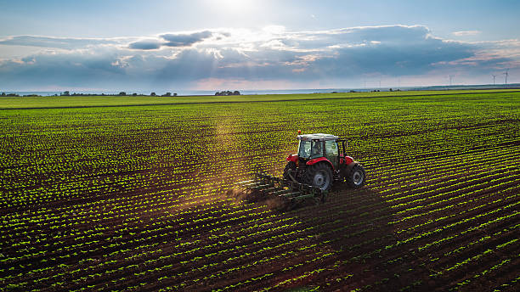
Future Prospects and Scaling
Land expansion for consistent production.
Establishment of a dedicated farmer training center focused on sustainable agriculture.

Slide 12
Environmental and Social Impact
Environmental Impacts
Reduction in Chemical Pollution.
Enhanced Biodiversity
Soil Health and Regeneration
Lower Carbon Footprint
Water Conservation
Promotion of Agroforestry
Social Impact
Job Creation and Economic Stability
Skills Development and Training
Improvement in Public Health
Empowerment of Local Communities
Food Security and Reduced Dependency on Imports
Raising Awareness of Sustainable Practices
Supporting Local Economies

Slide 13
Organizational Chart
Quality Assurance and Compliance
Farmer Engagement Officer
Marketing Team
Manager
Manager
Employee
Sales Team
Employee
Head of Supply Chain
Head of Sales and Marketing
Haed of Firming Operations
Manager
Manager
Manager
COO
CFO
Chief Operations Officer
Chief Financial Officer
CEO
Chief Executive Officer

Slide 14

Thanks!
Any Question?

Slide 15
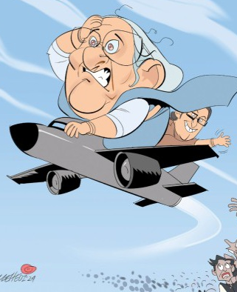
আমরা প্রশ্ন শুনে পালাই না…

